Slide 1

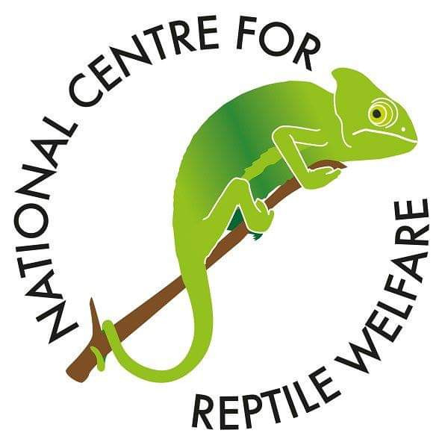

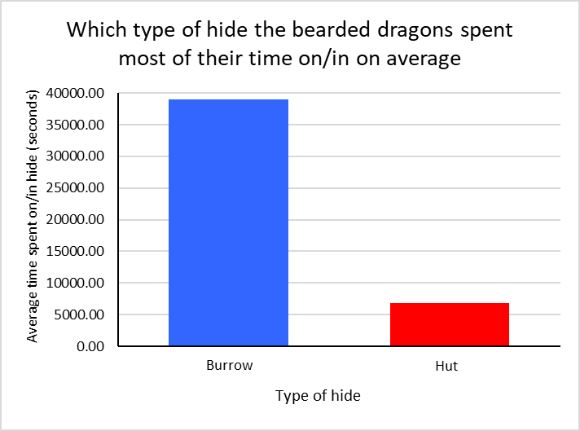
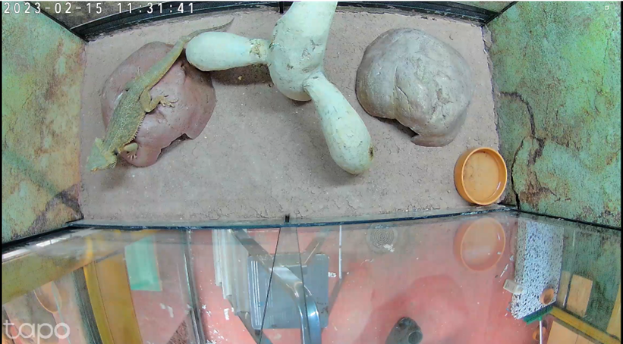
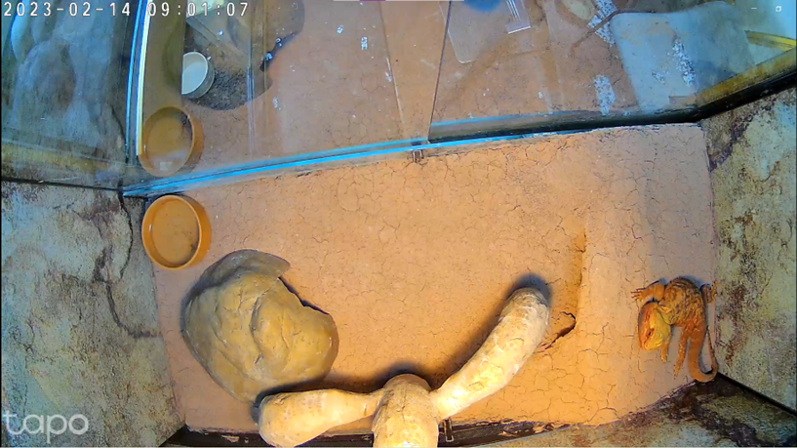
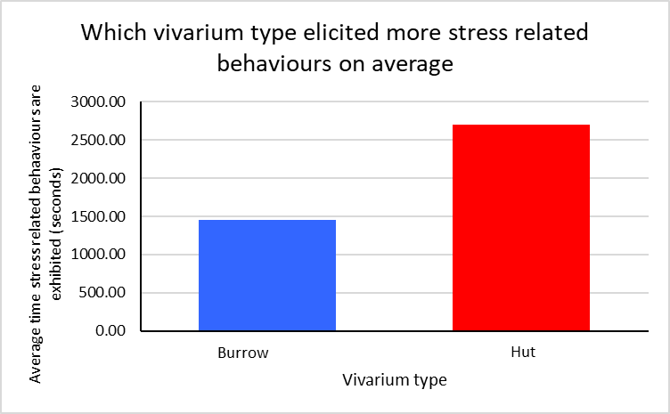
Do captive-bred bearded dragons prefer to use burrows or the huts used in their enclosures?
Abigail Thorley, BSc Hons Applied Behavioural Science and Welfare
Introduction
The central bearded dragon (Pongona vitticeps) is the most common species of bearded dragon in captivity and is becoming increasingly popular as a pet (Stahl, 1999). Found in desert conditions, bearded dragons have been known to construct burrows in the wild to control their body temperature, hide from predators, and as shelter during the warmer months (Howard, 2022).
Bearded dragons may exhibit stress related behaviours if they are not provided with the proper environment that corresponds to their wild habitat (Carlstead & Shepherdson, 2000). Common stress related behaviours seen in the bearded dragon are head bobbing, pacing and puffing up. Head bobbing is performed by these animals either during mating season or when they are feeling threatened (Vosjoli et al, 2001). Pacing, as with a lot of captive animals, is considered a stereotypic behaviour as it has no apparent goal and is often used as a way for an animal to cope with their environment (Rose, Nash & Riley, 2017). Puffing up is when the bearded dragon’s body becomes enlarged and the spikes running along their body and throat become more prominent, and has been shown when they are feeling unsafe and need to defend themselves (Green, 2009).
Materials and method
Two vivariums were selected to observe the bearded dragons in that could be altered to specific requirements. Both vivariums had the same materials of excavator clay and styrofoam used for the substrate. The vivariums were set up with one having a burrow (with the dimensions of length 28cm, width 46cm, and maximum height 11cm) that goes slightly underground.
The base layer for the substrate was styrofoam sheets then a layer of excavator clay mix was spread on top. For the vivarium with the burrow the styrofoam was carved and constructed using the excavator clay as adhesive so that the burrow appeared to go underground. The roof of the burrow was higher than the rest of the terrain to provide a raised platform to bask upon. For the vivarium without the burrow the Styrofoam sheets were slotted horizontally at the base and the excavator clay was layered on top. Video cameras were installed to give a bird’s eye view of both the vivariums. The vivariums were set up as shown in Fig 1 and Fig 2:
The heat lamp was positioned in the centre of the vivariums and set so the basking temperature of the climbing enrichment was recorded at 41°C for its warmest area (+/- 0.5°C). The huts and burrow were 38°C but had to be of the same temperatures to each other.
4 adult bearded dragons were selected and each spent a week in both the vivariums. Behaviour observations using the focal sampling method were carried out from looking at the video footage between 8:30am to 11:30am for 7 days, using a pre-constructed ethogram. The average time the bearded dragons spent in/on the burrow was calculated from the totals of each week, and the same was done for stress-related behaviours (head bobbing, pacing and puffing up) for each vivarium.
A chi-square (χ2) goodness of fit test was then performed to analyse if the average time spent on/in the different hut types was significantly different. The same test was used for the amount of stress related behaviours elicited from each vivarium type to identify if there is a significant difference.
Results so far
The data collection has only been fully completed and analysed for two out of the four weeks of the project, so the results shown below are from just two of the bearded dragons instead of four. This gives an idea of what the final results will look like.
From Fig 3 it is shown that the bearded dragons spent more time on average in/on the burrow compared to the hut in the vivarium. However for all of the behaviour observations the bearded dragons were not seen going into the burrow or hut once, just basking on top of them.
As seen in Fig 4 the bearded dragons showed more stress related behaviours in the vivarium with just the huts compared to the vivarium with the burrow and a hut.
Discussion
Since the data collection has only been fully completed and analysed for two out of the four weeks of the project the overall results could be significantly different. The two bearded dragons used in the second half of data collection are females, whereas these are males. This could affect the results as females and males have been known to behave differently.
Even though the bearded dragons weren’t seen going into the burrow during the behaviour observations, they still used the burrows for basking more than the huts.
The χ2 goodness of fit test on the results from Fig 3 resulted in a χ2 value of 22569.96, which was extremely high in relation to the chi squared distribution table and showed a very significant difference. The χ2 goodness of fit test performed on the results from Fig 4 came back with a χ2 value of 376.42, which is still very high and therefore shows the significant difference
This statistical analysis of the data therefore rejects both the null hypothesises that the bearded dragons would not have a preference of hut type, and there is not difference in the amount of stress related behaviours exhibited in the different vivarium types. This could mean that more captive bearded dragons should be provided with a burrow to reduce stress in these animals.
Fig 3: bar graph showing which hut type the bearded dragons spent most of their time on/in on average during the behaviour observations
Fig 1: view of hut vivarium from the video camera
Fig 2: view of burrow vivarium from the video camera
Fig 4: bar graph showing which type of vivarium elicited more stress related behaviours from the bearded dragons on average during the behaviour observations
Aims
The aim of this project is to determine if captive bred bearded dragons prefer to use underground burrows as their wild counterparts do, or if they prefer the huts typically used in their enclosures in captivity.
Conclusion
Burrows appear to be beneficial to captive bearded dragons in their vivariums as they use them more than huts and have been shown to elicit less stress related behaviours.
Null hypothesises
H0: The bearded dragons do not have a preference between hut or the burrow in their enclosures.
H0: There is no difference in the amount of stress related behaviours exhibited in the different vivarium types.
References
Carlstead, K. and Shepherdson, D. (2000) Alleviating stress in zoo animals with environmental enrichment. The biology of animal stress: basic principles and implications for animal welfare. Wallingford UK: Cabi Publishing
Green, D. (2009) Keeping Bearded Dragons. ABK Publications
Howard, J. (2022) ‘Seasons in the sun: Bearded Dragons in the Wild’. AHH/BHS Drayton Manor Conference 2022. 12 March. Tamworth
Rose, P. Nash, S. and Riley, L. (2017) ‘To pace or not to pace? A review of what abnormal repetitive behavior tells us about zoo animal management’ Journal of Veterinary Behaviour, vol. 20, p. 11-21
Stahl, S. (1999) ‘General Husbandry and Captive Propagation of Bearded Dragons’ Bulletin of the Association of Reptilian and Amphibian Veterinarians, vol. 9, p. 12-17
Vosjoli, P. Mailloux, R. Donoghue, S. Klingenberg, R. and Cole J. (2001) The Bearded Dragon Manual. California: Advanced Vivarium Systems

